Slide 1
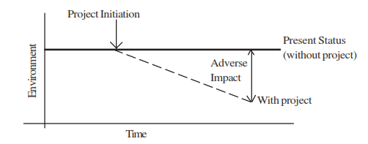
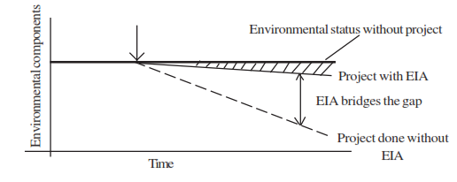
EIA & EMP

Slide 2
Environmental Impact Assessment (EIA)
Environmental Impact Assessment (EIA) is a process of evaluating the likely environmental impacts of a proposed project or development, taking into account inter-related socio-economic, cultural and human-health impacts, both beneficial and adverse. (ref)
It aims to predict environmental impacts at an early stage in project planning and design and find ways and means to reduce adverse impacts, shape projects to suit the local environment. (ref)

Slide 3
Environment - Indian Scenario
India is the first country to make provision and improvement of Environment (constitution 42nd Amendment)
Empowers state to make provision for environment protection and improvement (directive principle of state policy in Chapter - IV, Article 48A)
All citizen to protect and improve environment (fundamental duties Article 51Ag)

Slide 4
After stockholm conference on Human Environment, 1972
Water Act (Prevention and Control Act), 1974
Formation of CPCB, State PCBs
Water (Cess) Act, 1977
Air Act (Prevention and Control), 1981
Environment Protection Act, 1986
On Jan 27th 1996, under EPA, 1986, GoI advised that all expansion or modernisation of any activity or new project should undergo EIA process for clearing particular project/activity (EIA Notification - http://envfor.nic.in/legis/eia/so1533.pdf).

Slide 5
Institutional Framework
Govt, of India
Ministry of Environment and Forest
Central Pollution Control Board
Zonal Office
State Govt
Dept. of Environment
State Pollution Control Board
Regional Office

Slide 6
Values of EIA process
Integrity - objective, unbiased and balanced
Utility - balanced, credible information for decision making
Sustainability - should result in Environmental safeguard
Benefits of the EIA process ref
Potentially screens out environmentally-unsound projects
Proposes modified designs to reduce environmental impacts

Slide 7
Identifies feasible alternatives
Predicts significant adverse impacts
Identifies mitigation measures to reduce, offset, or eliminate major impacts
Engages and informs potentially affected communities and individuals
Influences decision-making and the development of terms and conditions

Slide 8
Roles in the EIA process
The Project Proponent
Prepare the DFR (Detailed Feasibility Report)
DFR make available to public
Approach SPCB for NOC
Apply IAA for environmental clearance
The Environmental Consultants
Guide the Proponent and prepare EIA report
Supply environmental related information to SPCB and IAA
Justify the findings in the EIA & EMP with experts group of IAA

Slide 9
State PCBs/ Pollution Control Committee
Responsible for assessing compatibility of the proposed development with current operational and prescribed standards
Issues NOC
Details of public hearing shall be forwarded to IAA
The Public
The concerned persons will be invited through press advertisement to review the information for environmental clearance

Slide 10
IAA
Evaluate and assess the EIA report
Set of recommendations and conditions for implementing the accepted project
Sets of conditions made available to public
Monitor the implementation and operational phase of the project

Slide 11
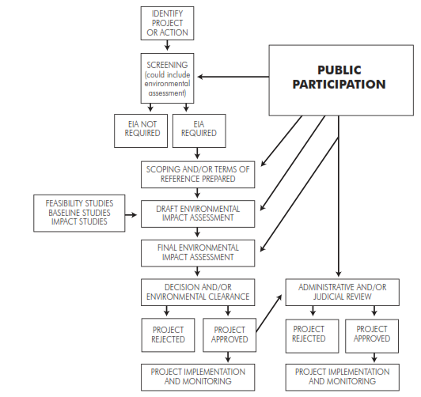
EIA - Cycle and Procedure ref
The EIA process in India is made of the following phases
Screening
Scoping
Collection of baseline data collection
Impact prediction
Mitigation measures and EIA report
Public hearing
Decision making
Monitoring and implementation of EMP
Source: https://www.elaw.org/files/mining-eia-guidebook/Chapter2.pdf

Slide 12
Screening: screened for scale of investment, location and type of development and if the project needs statutory clearance.
Scoping:The project’s potential impacts, zone of impacts, mitigation possibilities and need for monitoring done by EIA agency by following the published guidelines by the Ministry of Environment and Forest (MoEF) of government of India
Collection of baseline data: Baseline data is the environmental status of study area.

Slide 13
Impact prediction: Positive and negative, reversible and irreversible and temporary and permanent impacts need to be predicted for environmental components (Air, Noise, Water, Land, Biological Socioeconomic, Solid Waste)
Mitigation measures and EIA report: Actions and steps for preventing, minimizing or by passing the impacts or level of compensation for probable environmental damage or loss.
Public hearing: Public and environmental groups living close to project site may be informed and consulted.

Slide 14
Decision making: IAA along with the experts consult the project-in-charge along with consultant to take the final decision, keeping mind EIA and EMP
Monitoring and implementation of environmental management plan: The various phases of implementation of the project are monitored.
Risk assessment: Inventory analysis and hazard probability and index also form part of EIA procedures

Slide 15
Environmental Management Plan ref
EMP should include
Delineation of mitigation and compensation measures
Delineation of unmitigated impacts
Physical planning including work program, time schedule and locations for mitigation and compensation
Delineation of financial plan

Slide 16
The management plans should be necessarily based on considerations of resource conservation and pollution abatement
Liquid Effluents
Effluents from the industrial plants should be treated well to the standards as prescribed by the Central/State Water Pollution Control Boards.
Soil permeability studies should be made prior to effluents being discharged into holding tanks or impoundments and steps taken to prevent percolation and groundwater contamination.

Slide 17
Special precautions should be taken regarding flight patterns of birds in the area.Effluents containing toxic compounds,oil and grease have been known to cause extensive death of migratory birds.Location of plants should be prohibited in such type of sensitive areas.
Deep well burial of toxic effluents should not be resorted to as it can result in re-surfacing and groundwater contamination.Re-surfacing has been known to cause extensive damage to crop and livestocks.
In all cases,efforts should be made for re-use of water and its conservation.

Slide 18
Air Pollution
The emission levels of pollutants from the different stacks,should conform to the pollution control standards prescribed by Central or State Boards.
Adequate control equipment should be installed for minimising the emission of pollutants from the various stacks.
In-plant control measures should be taken to contain the fugitive emissions.

Slide 19
Infrastructural facilities should be provided for monitoring the stack emissions and measuring the ambient air quality including micro-meteorological data (wherever required) in the area.
Proper stack height as prescribed by the Central/State Pollution Control Boards should be provided for better dispersion of pollutants over a wider area to minimise the effect of pollution.
Community buildings and townships should be built up-wind of plant with one-half to one kilometer greenbelt in addition to physiographical barrier.

Slide 20
Solid Wastes
The site for waste disposal should be checked to verify permeability so that no contaminants percolate into the groundwater or river/lake.
Waste disposal areas should be planned down-wind of villages and townships.
Reactive materials should be disposed of by immobilising the reactive materials with suitable additives.
The pattern of filling disposal site should be planned to create better landscape and be approved by appropriate agency and the appropriately pretreated solid wastes should be disposed according to the approved plan.

Slide 21
Intensive programs of tree plantation on disposal areas should be undertaken.
Noise and Vibration
Adequate measures should be taken for control of noise and vibrations in the industry.
Occupational Safety and Health
Proper precautionary measures for adopting occupational safety and health standards should be taken.
Housekeeping
Proper house-keeping and cleanliness should be maintained both inside and outside of the industry.

Slide 22
Prevention,maintenance and operation of Environment Control Systems
Adequate safety precautions should be taken during preventive maintenance and shutdown of the control systems.
A system of inter-locking with the production equipment should be implemented where highly toxic compounds are involved.
Vegetal Cover
Industries should plant trees and ensure vegetal cover in their premises.This is particularly advisable for those industries having more than 10 acres of land.

Slide 23
Transport Systems
Proper parking places should be provided for the trucks and other vehicles by the industries to avoid any congestion or blocking of roads.
Siting of industries on the highways should be avoided as it may add to more road accidents because of substantial increase in the movements of heavy vehicles and unauthorised shops and settlements coming up around the industrial complex.

Slide 24
Spillage of chemicals/substances on roads inside the plant may lead to accidents.Proper road safety signs both inside and outside the plant should be displayed for avoiding road accidents.
Recovery - reuse of waste products
Efforts should be made to recycle or recover the waste materials to the extent possible.The treated liquid effluents can be conveniently and safely used for irrigation of lands,plants and fields for growing non-edible crops.

Slide 25
Disaster Planning
Proper disaster planning should be done to meet any emergency situation arising due to fire,explosion,sudden leakage of gas etc.Fire fighting equipment and other safety appliances should be kept ready for use during disaster/emergency situation including natural calamities like earthquake/flood.
Environment Management Cell
Each industry should identify within its set up a Department/Section/Cell with trained personnel to take up the model responsibility of environmental management as required for planning and implementation of the projects.

